Slide 1
Image Alignment
CSC 249/449 Spring 2019
http://www.cs.rochester.edu/~cxu22/t/249S19/
Instructor: Chenliang Xu
chenliang.xu@rochester.edu

Slide 2


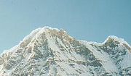
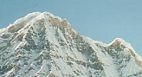
Local features: main components
Feature Detection Identify the interest points
Feature Description Extract vector feature descriptor surrounding each interest point
Feature Matching Determine correspondence between descriptors in two views
Image Alignment Compute a transformation matrix between two images
Adapted from: K. Grauman

Slide 3
Review questions
What is the purpose of the “ratio test” for local feature matching?
What aspects of the SIFT descriptor design promote robustness to lighting changes? Robustness to rotation and scale?
Does extracting multiple keypoints for multiple local maxima in scale space help recall or precision during feature matching?
How far in the image plane can an object rotate before the SIFT descriptors will not match?

Slide 4
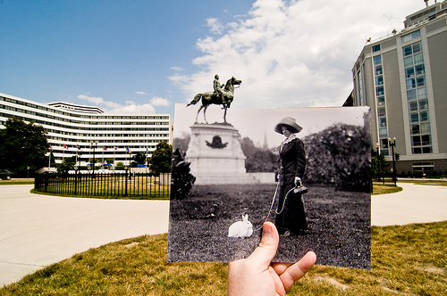
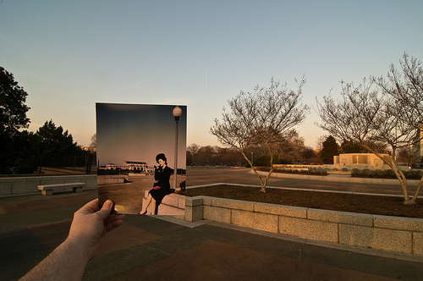
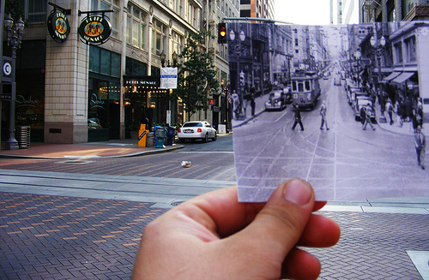
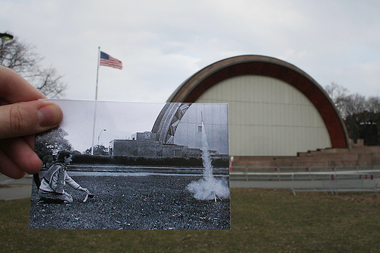
A look into the past
http://blog.flickr.net/en/2010/01/27/a-look-into-the-past/

Slide 5
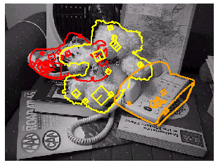
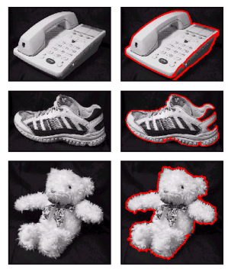
Image alignment: Applications
Recognition of object instances
Source: S. Lazebnik

Slide 6


Image alignment: Challenges
Small degree of overlap
Intensity changes
Occlusion, clutter
Source: S. Lazebnik

Slide 7
Robust feature-based alignment
Source: L. Lazebnik

Slide 8

Coming up: robust feature-based alignment
Extract features
Source: L. Lazebnik

Slide 9
Coming up: robust feature-based alignment
Extract features
Compute putative matches
Source: L. Lazebnik

Slide 10
Coming up: robust feature-based alignment
Extract features
Compute putative matches
Loop:
Hypothesize transformation T (small group of putative matches that are related by T)
Source: L. Lazebnik

Slide 11
Coming up: robust feature-based alignment
Extract features
Compute putative matches
Loop:
Hypothesize transformation T (small group of putative matches that are related by T)
Verify transformation (search for other matches consistent with T)
Source: L. Lazebnik

Slide 12
Coming up: robust feature-based alignment
Extract features
Compute putative matches
Loop:
Hypothesize transformation T (small group of putative matches that are related by T)
Verify transformation (search for other matches consistent with T)
Source: L. Lazebnik

Slide 13
Now
Feature-based alignment
2D transformations
Affine fit
RANSAC for robust fitting

Slide 14
Alignment as fitting
Previous lectures: fitting a model to features in one image
Alignment: fitting a transformation between pairs of features (matches) in two images
M
x_{i}
Find model M that minimizes
x_{i}
x_{i}
Find transformation T that minimizes
'
T
Adapted from: Lana Lazebnik

Slide 15
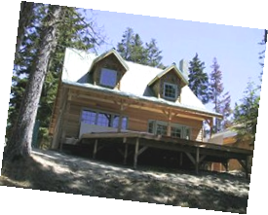
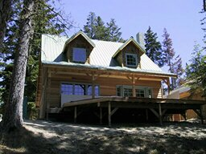
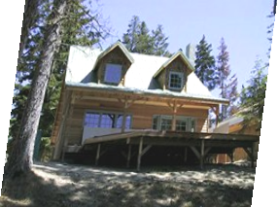
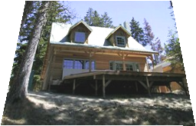
Parametric (global) warping
Examples of parametric warps:
translation
rotation
aspect
perspective
affine
Source: Alyosha Efros

Slide 16
Parametric (global) warping
T
p = (x,y)
p’ = (x’,y’)
Transformation T is a coordinate-changing machine:
p’ = T(p)
What does it mean that T is global?
Is the same for any point p
can be described by just a few numbers (parameters)
Let’s represent T as a matrix:
p’ = Mp
Source: Alyosha Efros

Slide 17
Scaling
Scaling a coordinate means multiplying each of its components by a scalar
Uniform scaling means this scalar is the same for all components:
× 2
Source: Alyosha Efros

Slide 18
Scaling
Non-uniform scaling: different scalars per component:
X × 2, Y × 0.5
Source: Alyosha Efros

Slide 19
Scaling
Scaling operation:
Or, in matrix form:
scaling matrix S
Source: Alyosha Efros

Slide 20
What transformations can be represented with a 2x2 matrix?
2D Scaling?
2D Rotate around (0,0)?
2D Shear?
Source: Alyosha Efros

Slide 21
What transformations can be represented with a 2x2 matrix?
2D Mirror about Y axis?
2D Mirror over (0,0)?
2D Translation?
NO!
Source: Alyosha Efros

Slide 22
2D Linear Transformations
Only linear 2D transformations can be represented with a 2x2 matrix.
Linear transformations are combinations of …
Scale,
Rotation,
Shear, and
Mirror
Source: Alyosha Efros

Slide 23
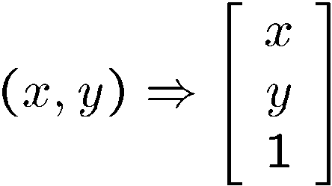
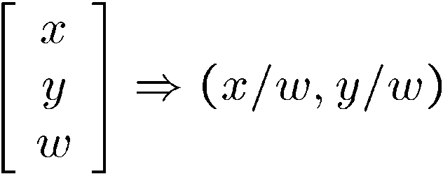
Homogeneous coordinates
To convert to homogeneous coordinates:
homogeneous image
coordinates
Converting from homogeneous coordinates

Slide 24
Homogeneous Coordinates
Q: How can we represent 2d translation as a 3x3 matrix using homogeneous coordinates?
A: Using the rightmost column:
Source: Alyosha Efros

Slide 25
Translation
Homogeneous Coordinates
t_{x} = 2 t_{y} = 1
Source: Alyosha Efros

Slide 26
Basic 2D Transformations
Basic 2D transformations as 3x3 matrices
Translate
Scale
Rotate
Shear
Source: Alyosha Efros

Slide 27
2D Affine Transformations
Affine transformations are combinations of …
Linear transformations, and
Translations
Parallel lines remain parallel

Slide 28
Now
Feature-based alignment
2D transformations
Affine fit
RANSAC for robust fitting

Slide 29
Image alignment
Two broad approaches:
Direct (pixel-based) alignment
Search for alignment where most pixels agree
Feature-based alignment
Search for alignment where extracted features agree
Can be verified using pixel-based alignment

Slide 30
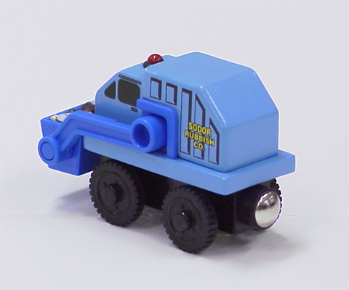

Let’s start with affine transformations
Simple fitting procedure (linear least squares)
Approximates viewpoint changes for roughly planar objects and roughly orthographic cameras
Can be used to initialize fitting for more complex models
Source: S. Lazebnik
Notes:
Affine transformation (6 DOF, parallel line still parallel) v.s. Homography transformation (8 DOF)

Slide 31
Fitting an affine transformation
Assume we know the correspondences, how do we get the transformation?
Want to find M, t to minimize

Slide 32
Fitting an affine transformation
Assume we know the correspondences, how do we get the transformation?

Slide 33
Fitting an affine transformation
Linear system with six unknowns.
Each match gives us two linearly independent equations.
How many pairs of features do we need?
need at least three to solve for the transformation parameters

Slide 34
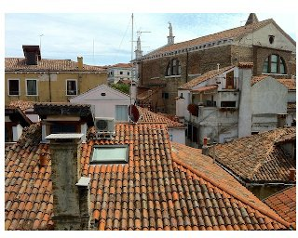
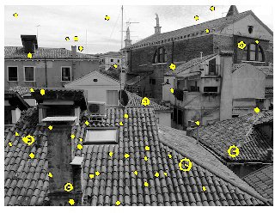
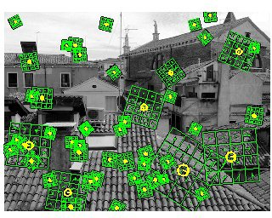
Recall: Scale Invariant Feature Transform (SIFT) descriptor [Lowe 2004]
Interest points and their scales and orientations
(random subset of 50)
SIFT descriptors
http://www.vlfeat.org/overview/sift.html
Kristen Grauman
http://www.vlfeat.org/overview/sift.html

Slide 35
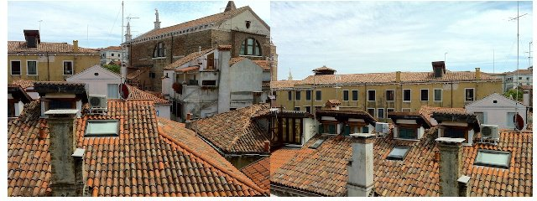
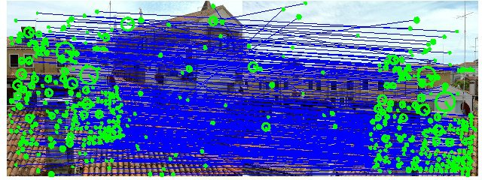
Recall: SIFT (preliminary) matches
http://www.vlfeat.org/overview/sift.html
Kristen Grauman
http://www.vlfeat.org/overview/sift.html

Slide 36
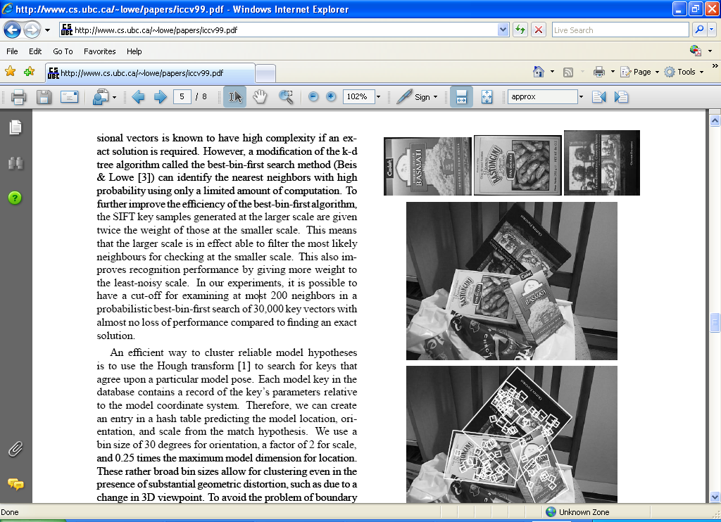
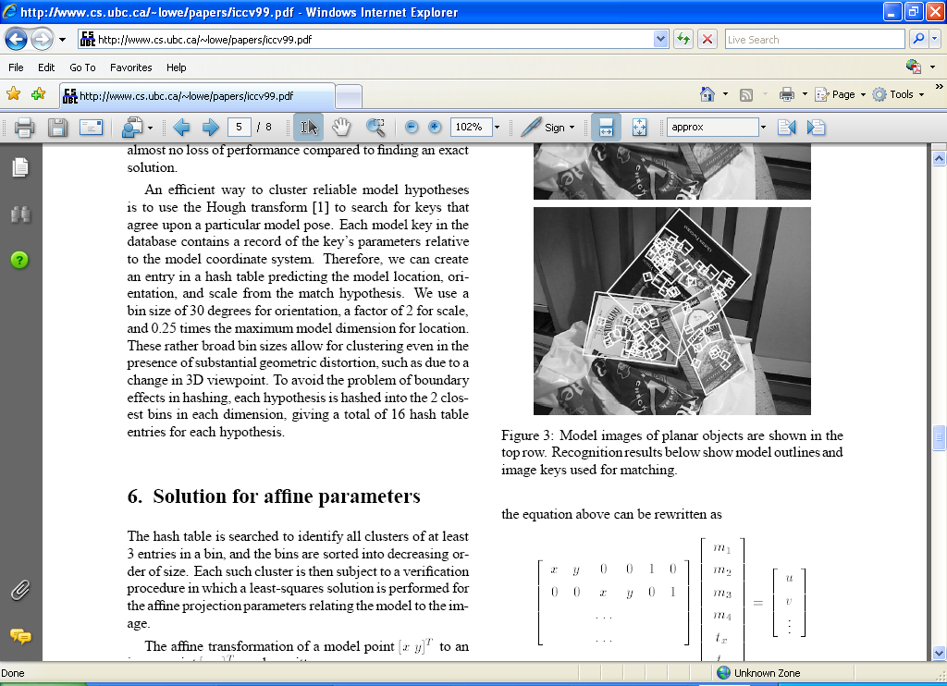
Fitting an affine transformation
Affine model approximates perspective projection of planar objects.
Figures from David Lowe, ICCV 1999
Notes:
Again Affine v.s. Homography transformation

Slide 37
Now
Feature-based alignment
2D transformations
Affine fit
RANSAC for robust fitting

Slide 38
Recall: SIFT (preliminary) matches
Not all of these are valid matches!
http://www.vlfeat.org/overview/sift.html
Kristen Grauman
http://www.vlfeat.org/overview/sift.html

Slide 39
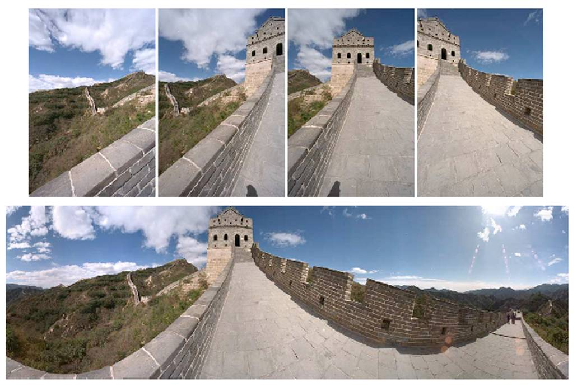
Outliers
Outliers can hurt the quality of our parameter estimates, e.g.,
an erroneous pair of matching points from two images
Analogues to: an edge point that is noise, or doesn’t belong to the line we are fitting.
Kristen Grauman

Slide 40
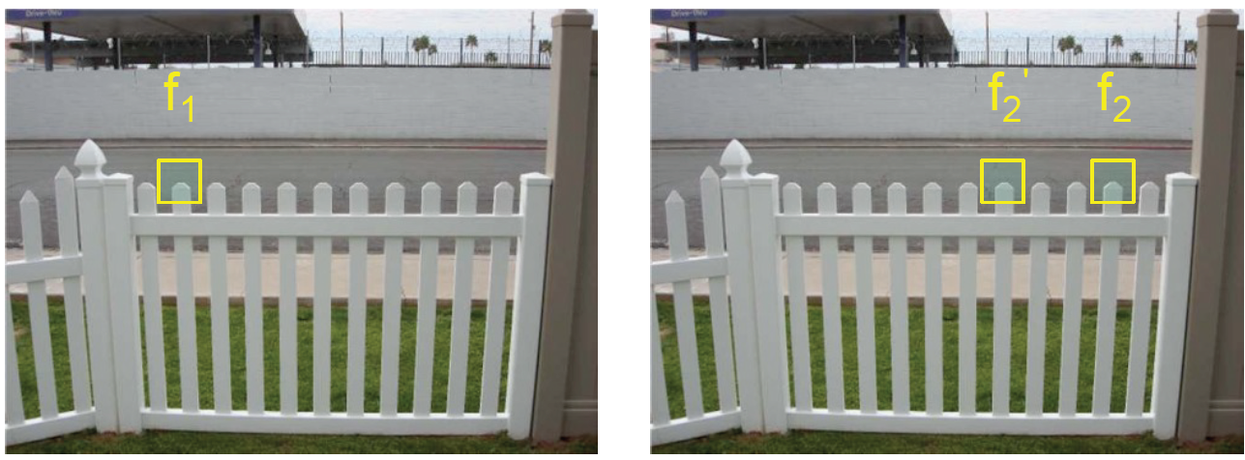
Problem: Ambiguous putative matches
Source: Y. Furukawa

Slide 41
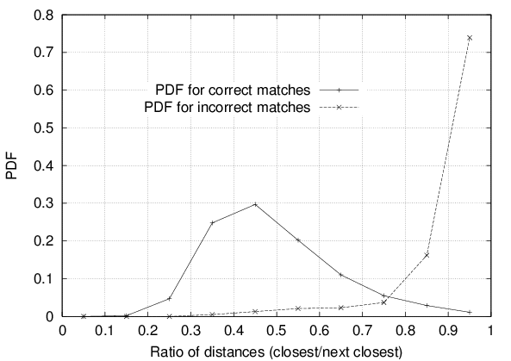
Recall: Rejection of unreliable matches
How can we tell which putative matches are more reliable?
Heuristic: compare distance of nearest neighbor to that of second nearest neighbor (Ratio Test)
Ratio of closest distance to second-closest distance will be high for features that are not distinctive
Threshold of 0.8 provides good separation
David G. Lowe. "Distinctive image features from scale-invariant keypoints.” IJCV 60 (2), pp. 91-110, 2004.
Source: S. Lazebnik
Notes:
Probability Density Function

Slide 42
RANSAC
The set of putative matches contains a very high percentage of outliers
RANSAC loop:
Randomly select a seed group of matches
Compute transformation from seed group
Find inliers to this transformation
If the number of inliers is sufficiently large, re-compute least-squares estimate of transformation on all of the inliers
Keep the transformation with the largest number of inliers
Source: S. Lazebnik

Slide 43
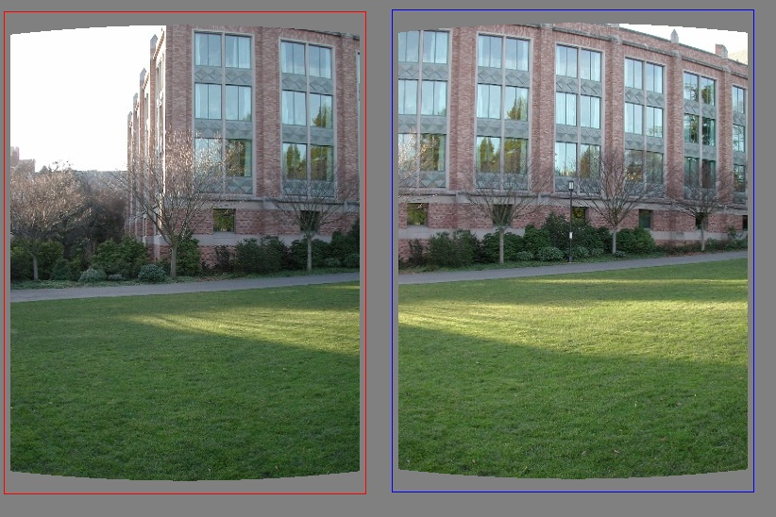
RANSAC example: Translation
Putative matches
Source: S. Lazebnik

Slide 44
RANSAC example: Translation
Select one match, count inliers
Source: S. Lazebnik
Notes:
Why do you need just one match?

Slide 45
RANSAC example: Translation
Select one match, count inliers
Source: S. Lazebnik

Slide 46
RANSAC example: Translation
Select translation with the most inliers
Source: S. Lazebnik

Slide 47
Recap
Feature-based alignment
2D transformations
Affine fit
RANSAC for robust fitting
Next: Motion and Tracking
Textbook Sec. 8.1, 8.4 (optional)

